Slide 1


WEATHER CONDITIONS & CLIMATE CHANGE WITH CLIMATEWINS
Asad Agha
April 2025

Slide 2
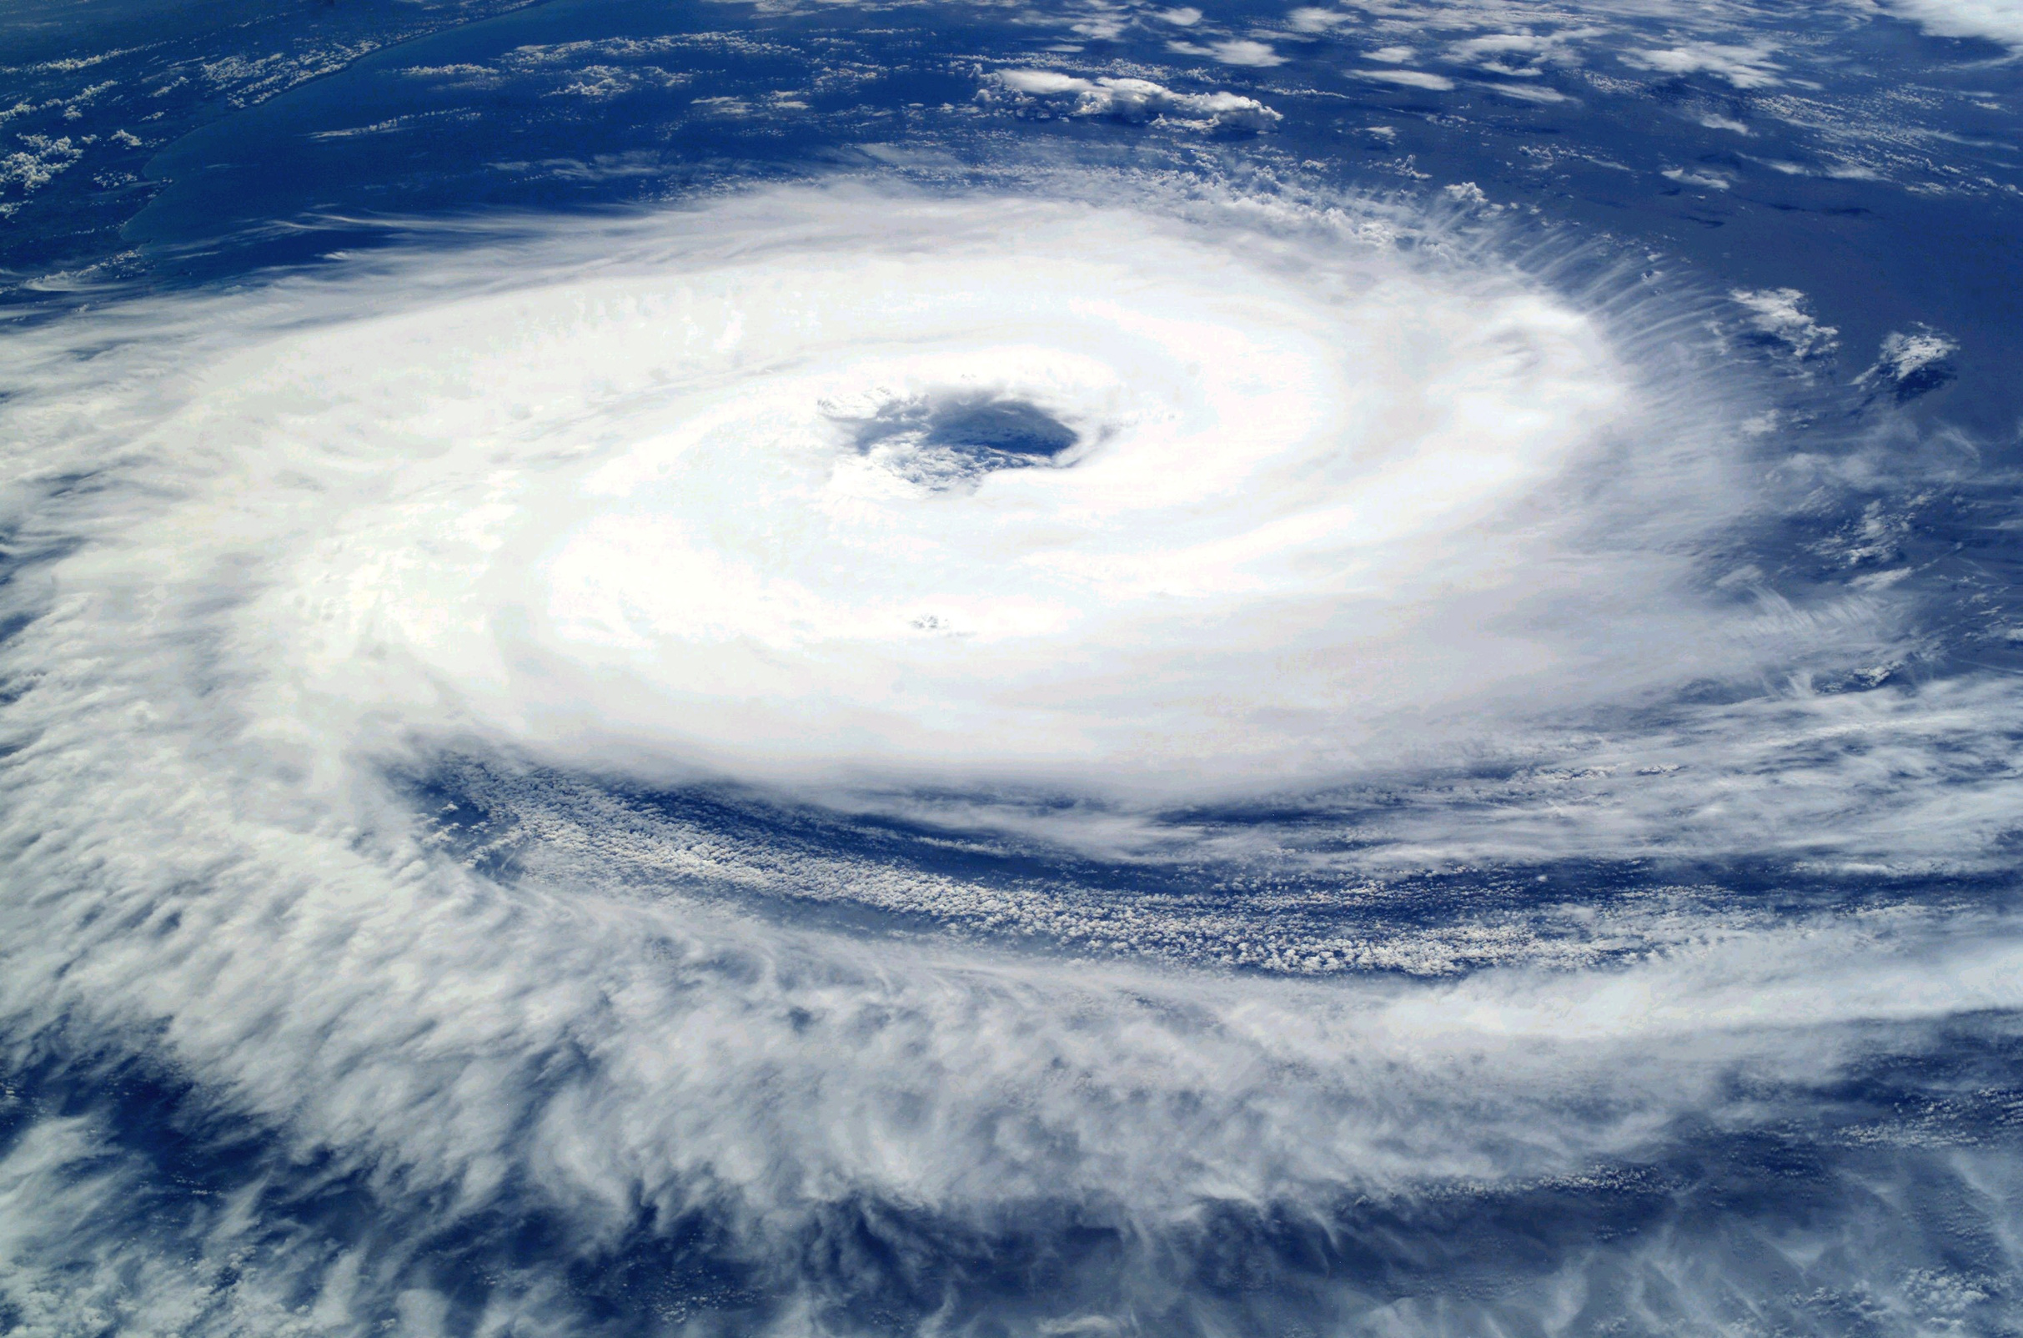
OBJECTIVE
Using machine learning to make predictions on the consequences of climate change around Europe and potentially the world.

Slide 3
HYPOTHESES
1
2
3
Machine learning models trained on historical weather data can accurately predict the rising frequency of extreme weather events across Europe.
Prediction accuracy is likely to differ depending on geographic location and the range of climate conditions within the region.
Supervised learning models are expected to be especially effective in predicting specific weather conditions.

Slide 4

DaTA SOURCE
The weather dataset was collected from 18 different weather stations across Europe, containing records spanning from the late 1800s up to 2022.
Observations were recorded almost daily, covering measurements such as wind speed, temperature, and global radiation, among others.
This dataset was collected by the European Climate Assessment & Dataset Project.

Slide 5
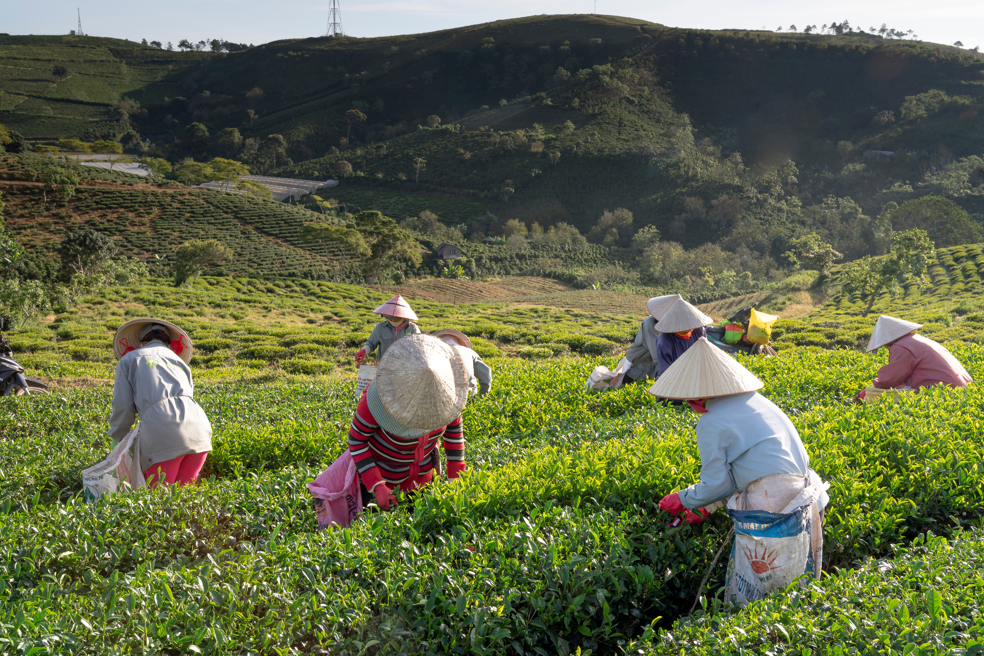
DATA BIAS & ACCURACY
Collection Bias: The data comes from 18 weather stations across Europe, even though there are over 26,321 stations available. This limited sample may not fully represent the diverse climates found throughout Europe.
Temporal Bias: The dataset covers a period from the late 1800s to 2022. Older records might not accurately reflect current climate conditions, which could potentially lead to misleading results when used in machine learning models.

Slide 6
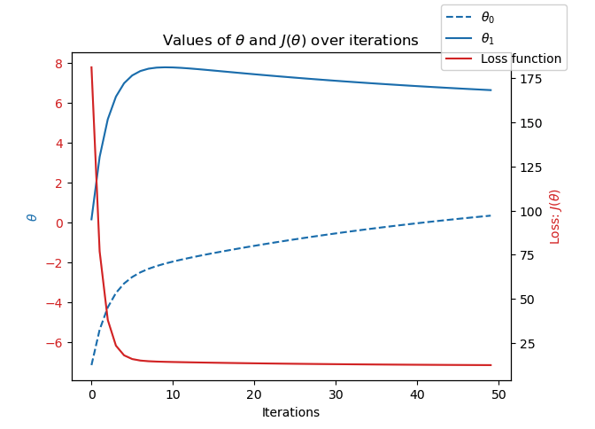
OPTIMIZATION
Gradient descent was used to optimize temperature data in this project.
It uses the derivative of the function at any point to minimize the loss function by updating parameters on an iterative basis.
Iterative optimization managed to reduce the loss function to almost zero.

Slide 7
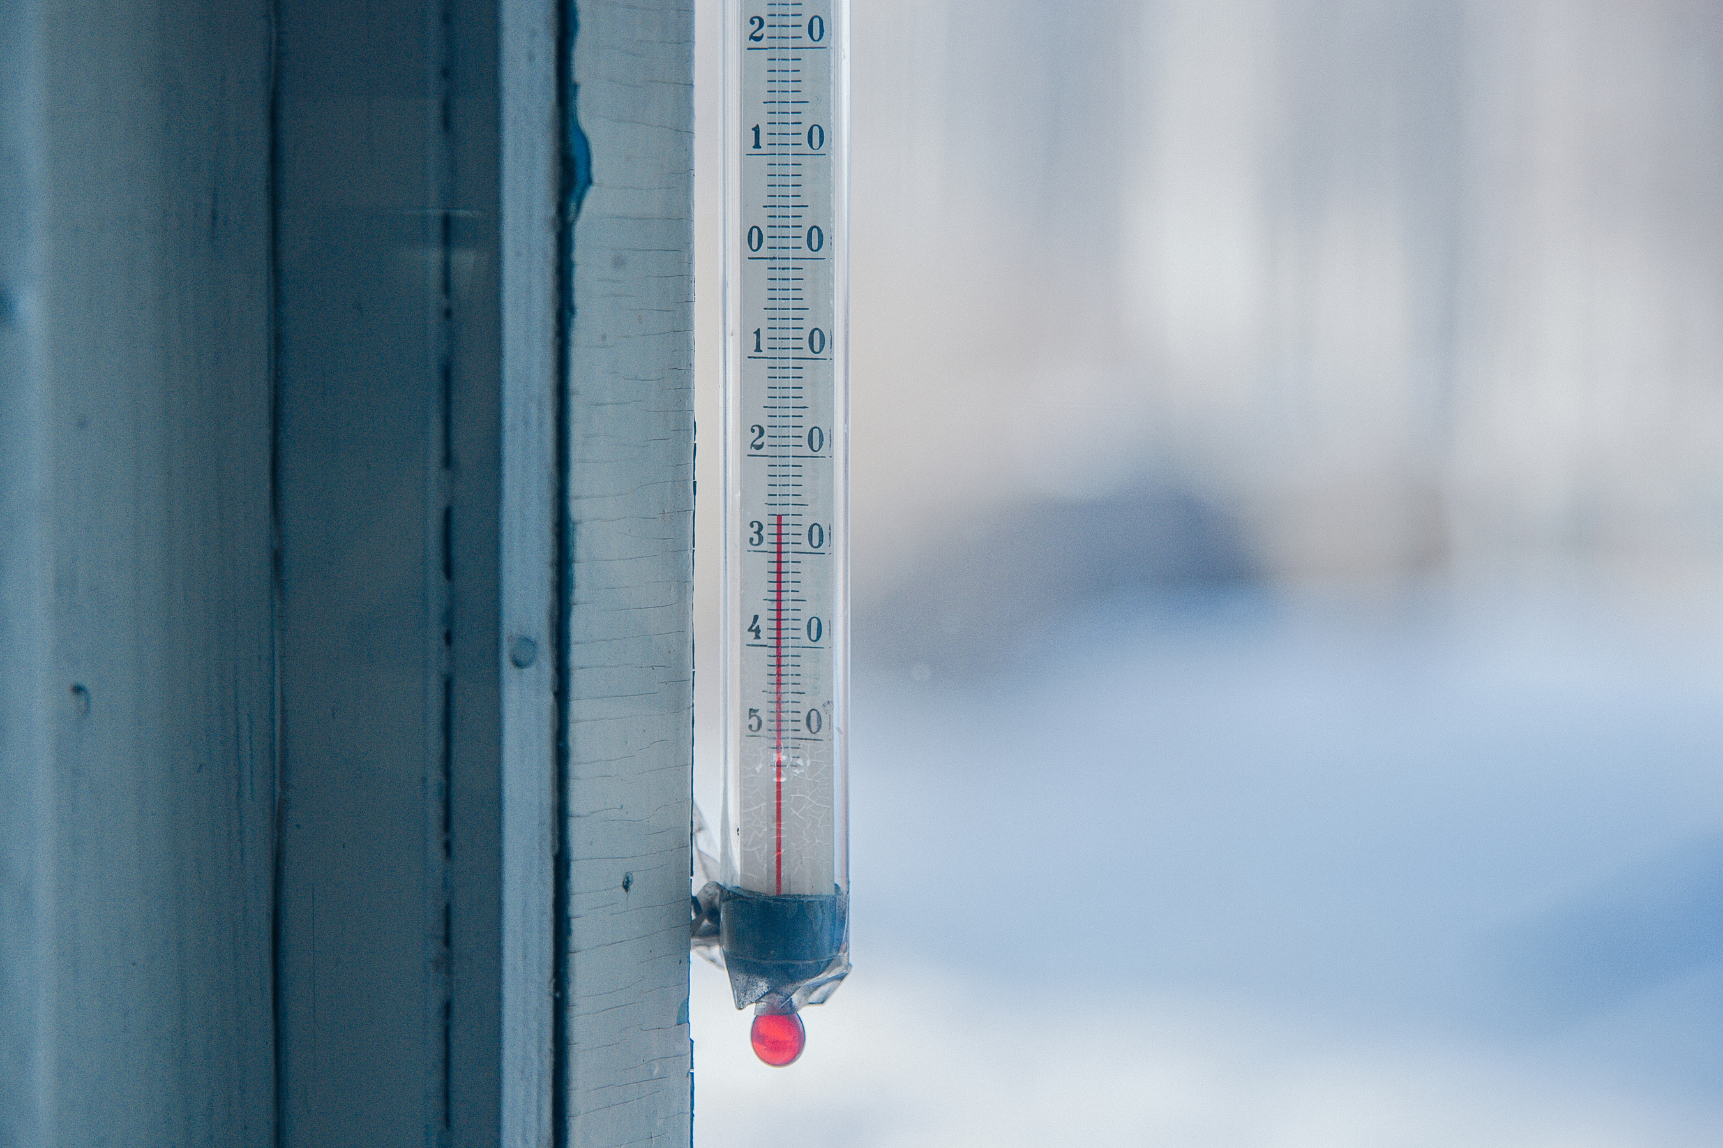
SUPERVISED MACHINE LEARNING ALGORITHMS USED
The supervised machine learning algorithms used in this project are K-Nearest Neighbors (KNN), Decision Tree, and Artificial Neural Network (ANNs).

Slide 8
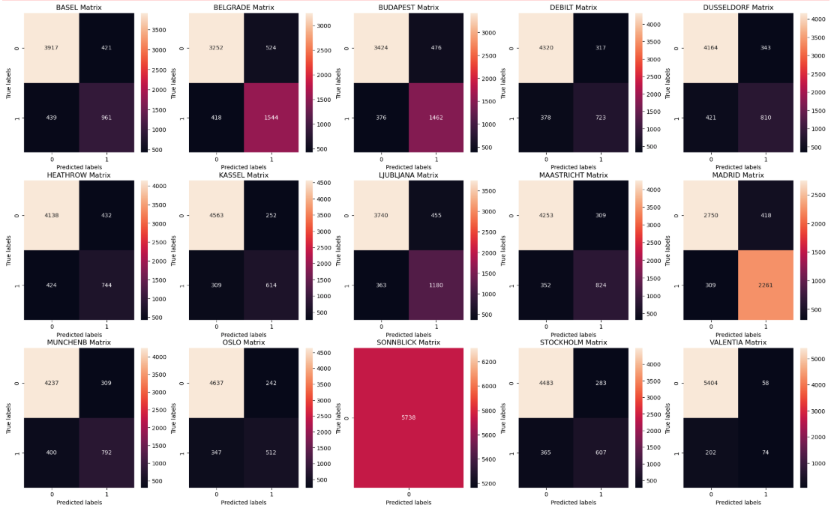
K-Nearest Neighbors (KNN)
The k-nearest neighbors (KNN) algorithm predicts by calculating the distance between a new data point and existing nearby points (neighbors). It then assigns the new point to the group that has the majority among these neighbors.
The average accuracy for this model was 88%.

Slide 9
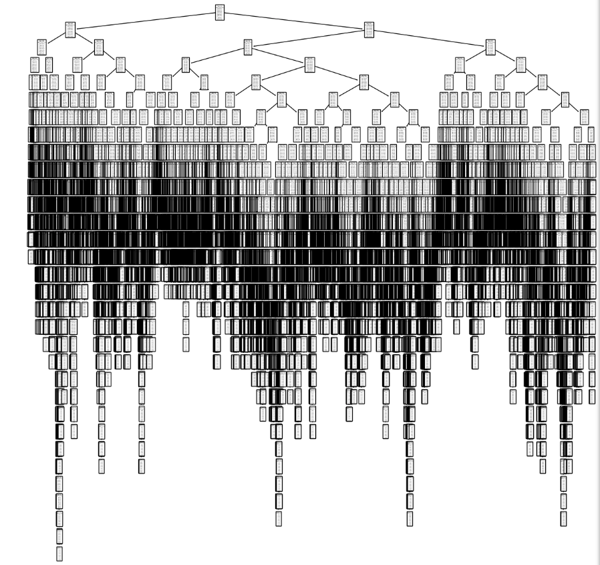
Decision Tree
A decision tree predicts outcomes by asking a sequence of questions about the data’s features.
The tree is made up of nodes and branches, where new data points move through the tree following the path that best matches their characteristics.
The accuracy for this model was 47%.

Slide 10
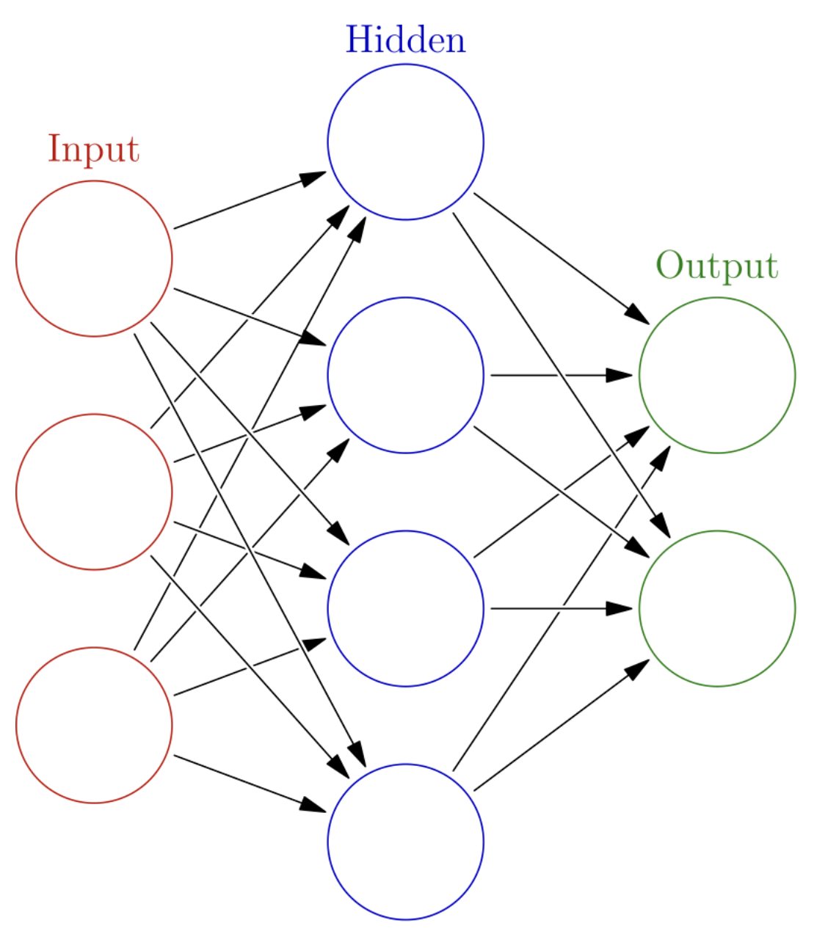
Artificial neural network (Ann)
Artificial neural networks (ANNs), inspired by the human brain, predict outcomes by processing data through multiple interconnected layers. The input layer receives the initial data, assigning weights based on connections to hidden layers. These hidden layers then apply specific functions to the weighted inputs and pass the resulting information to the output layer.
The accuracy for this model was 49%.

Slide 11

Algorithm best suited for the project
The K-Nearest Neighbor (KNN) algorithm achieved the highest accuracy of 88%; therefore, it is recommended that Climatewins utilize this algorithm to predict if the weather will be suitable for a picnic.

Slide 12
Summary & next steps
The aim of this project is to apply machine learning techniques to predict the impacts of climate change.
Our analysis demonstrated that machine learning algorithms can forecast future weather conditions with accuracies of up to 89%.
Additional variables beyond temperature can also be included to assess if they improve the accuracy of weather predictions.
We will continue to explore how unsupervised learning algorithms can be effectively used to predict weather conditions.

Slide 13
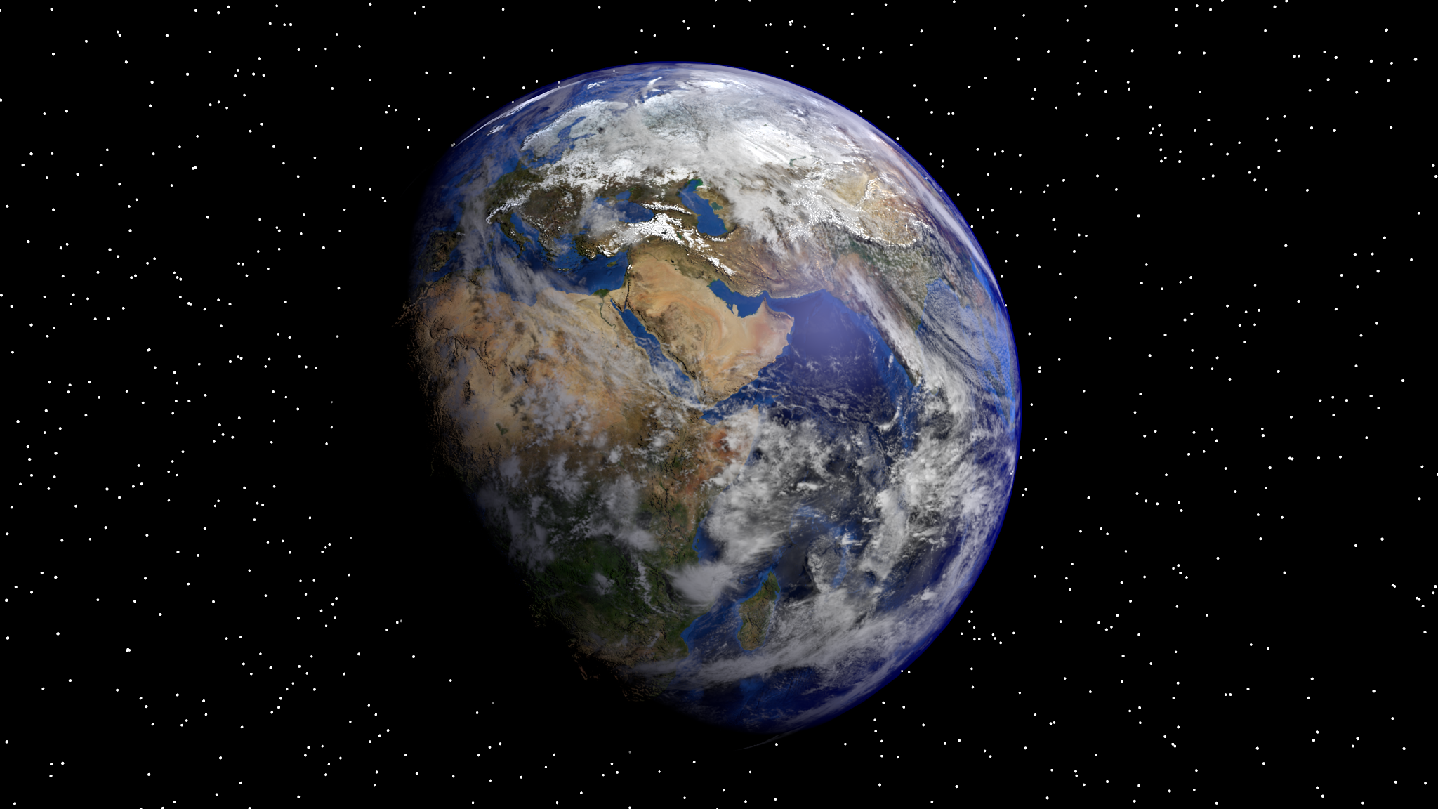
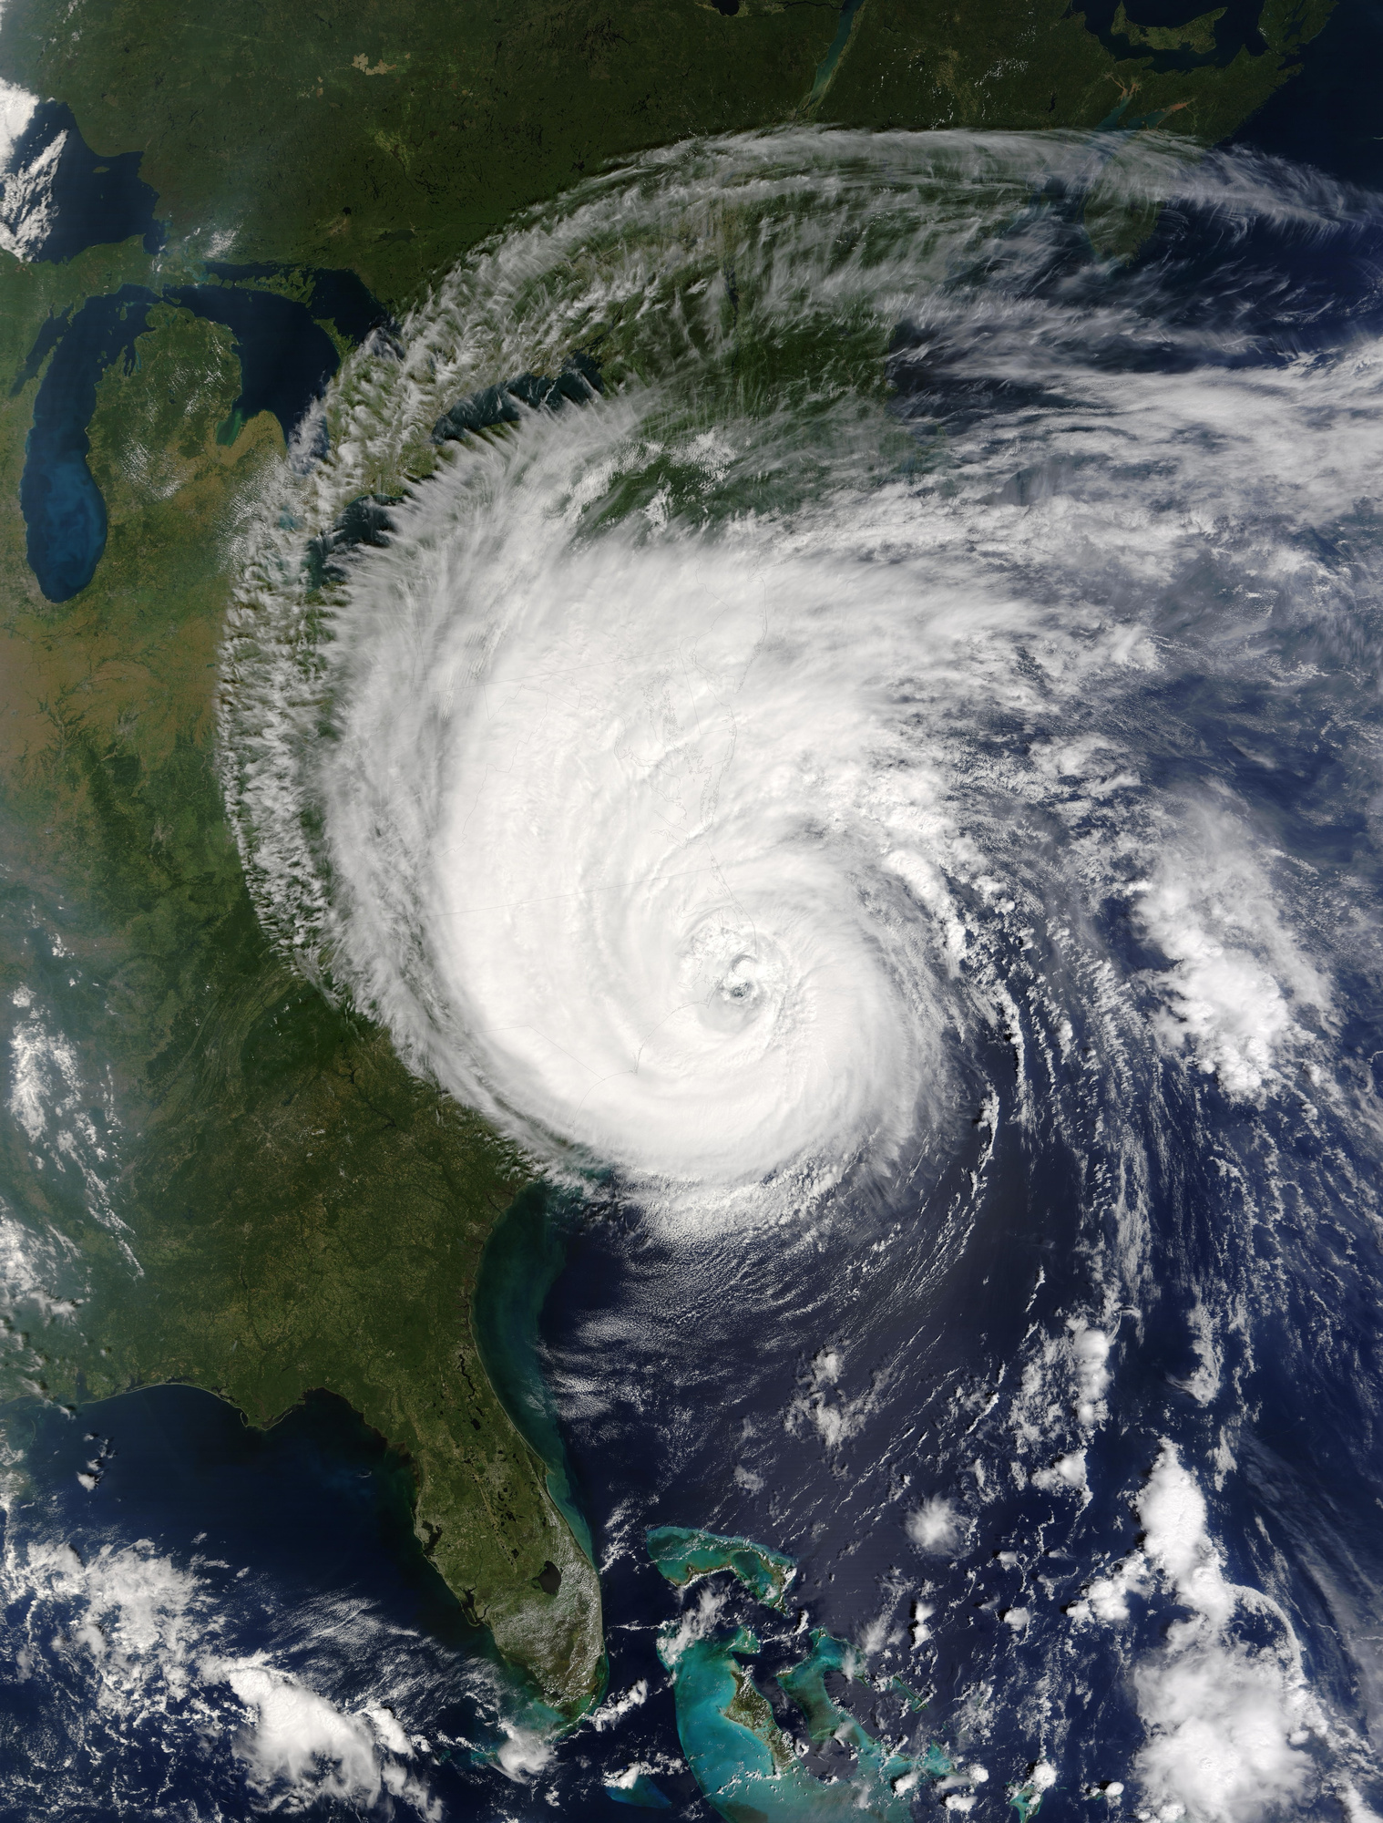
THANK YOU!

